Slide 1
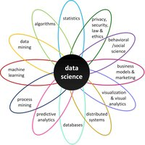

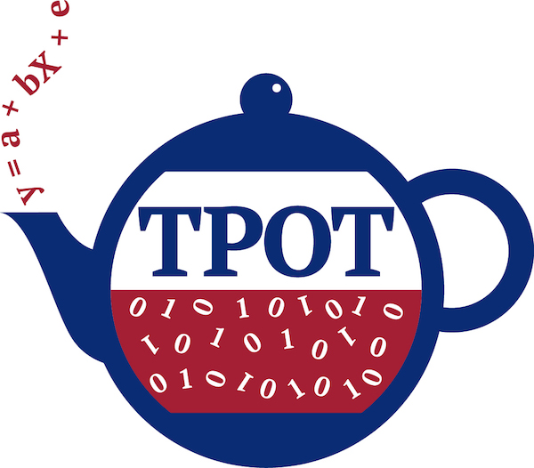

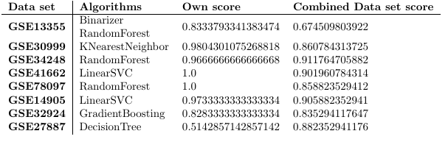
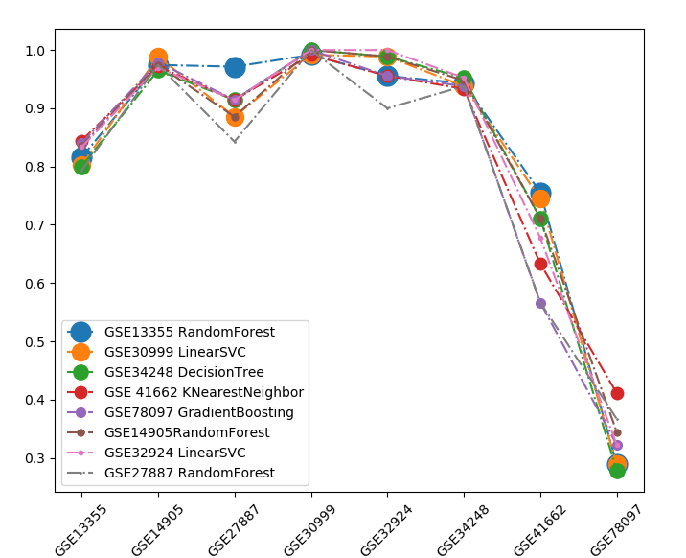
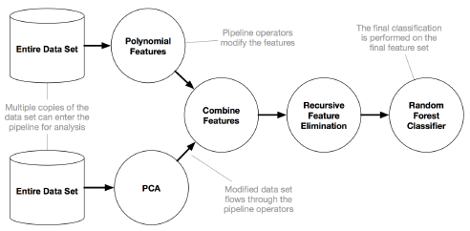
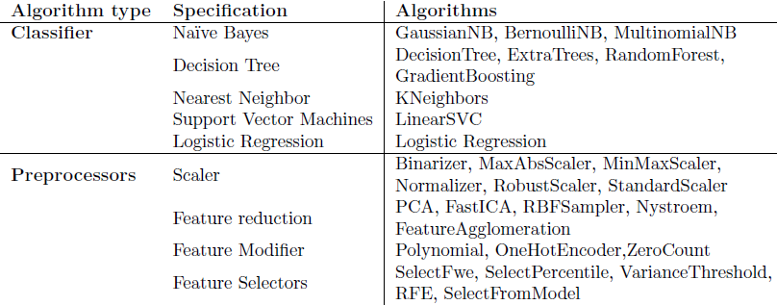
How does TPOT perform on specific biomedical data set problems and how can it be improved?
TPOT’s performance for
Biomedical Data
Tim Beishuizen
Supervisor: Joaquin Vanschoren
Biomedical Data
Challenges
Several biomedical data challenges are known:
Volume: A large or small data set
Dimensionality: A large number of features
Complexity: The data is stored in a complex way
Heterogeneity: The data has differences to different origins
Quality: The quality of the values is low
Skin disease data set
Details:
Originated from NCBI
Psoriasis and Atopic Dermatitis (Eczema)
Nine data sets
The feature set: 54676 genes
Sample size: between 28 and 180
Normal skin
Non-lesional skin (not affected by disease)
Lesional skin (affected by disease)
The challenges that are available in this data set:
Heterogeneity: Nine data sets needed to be combined
Dimensionality: The 54676 genes
Volume: A very low number of samples
TPOT
Tree-based Pipeline Optimization tool
TPOT is an automated machine learning tool that tries to find the best machine learning pipeline to correclty explain the behaviour of the data.
TPOT Outline
TPOT Algorithms
Results
Initialization problems
Memory issues: The high dimensionality slowed down the process significantly
The feature agglomeration algorithm had to be removed, due to freezing the cpu.
One data set had an error and needed to be removed.
Combined data set pipeline
LogisticRegression(C=0.0001, dual=True, penalty='l2'), GradientBoostingClassifier(learning rate=0.1, max depth=5, max features=0.05, min samples leaf=12, min samples split=19, n estimators=100, subsample=0.5)
Pipeline Results
Pipeline scores for each data set
Final score
The final score of the combined data set pipeline was 0.913725490196. It is a reasonable score, considering the values should differ between the different data sets. Comparing this score with the scores of the combined data set with the other data set, this was the best scoring pipeline.
Conclusion
TPOT can tackle the biomedical data challenges reasonably. There are problems regarding memory issues because of the high dimensionality and scoring issues with the low number of samples. However the final result is good.
Since not all biomedical data challenges were present in the data set, future research could be done on those. Also extensions could be made to TPOT to address the found issues to it.
/ Data Mining – Computer Science and Engineering

